Slide 1
Final Research Presentation
Team: Feed Mid
Mengyao Cai
Zhihang Jin

Slide 2
Outline
Needs Analyses
Matrix
Design
Time table
Conclusion

Slide 3
Needs Analyses
5% of annual budget
Make an improvement to campus
Improve the anteroom
Heating control system

Slide 4
Constraints & Criteria
Constraints
Criteria
No more than 5% of annual budget ($ 8 million)
Transform all the anterooms of campus building
Shouldn’t change main building structure of buildings
Durable
Cheap
Efficiency
Safe

Slide 5
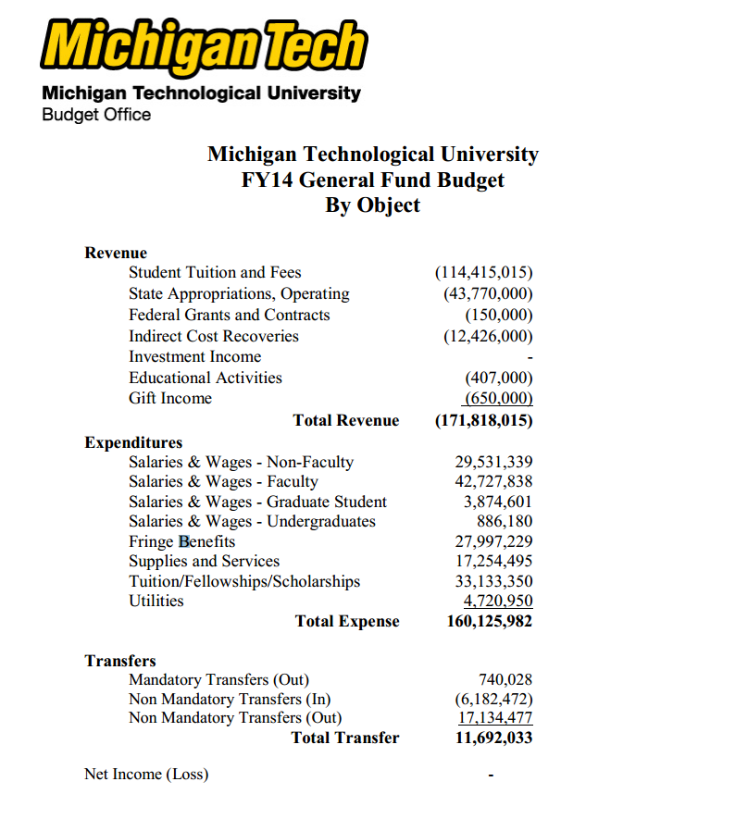
Our Budget
$160,125,982 * 5% = $8,006,299.1
8 millions dollar cap

Slide 6
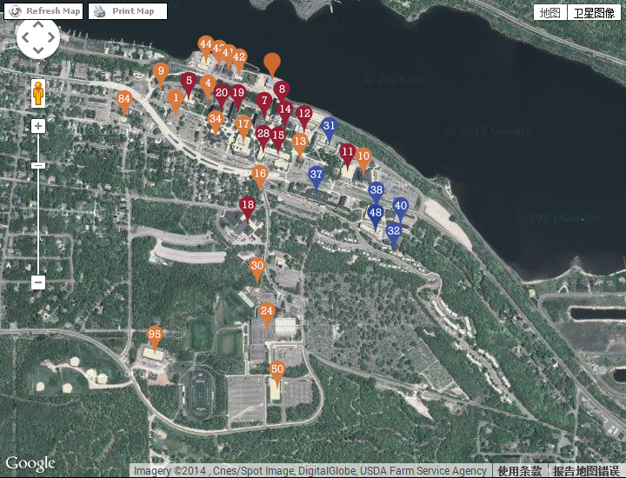
Campus Map
Red: Academic building
Blue: Residence Building
Orange: Other building
Total 320 doors

Slide 7
Matrix
 | weight | individual self-heating | net power transfer | foot board self-heating | computer control
cost | 20% | 7 | 5 | 8 | 9
efficiency | 30% | 7 | 9 | 4 | 5
durable | 30% | 8 | 6 | 7 | 6
safety | 20% | 8 | 6 | 7 | 8
total | 100% | 75 | 67 | 63 | 67

Slide 8
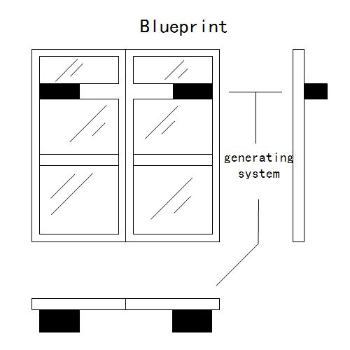
Blueprint

Slide 9
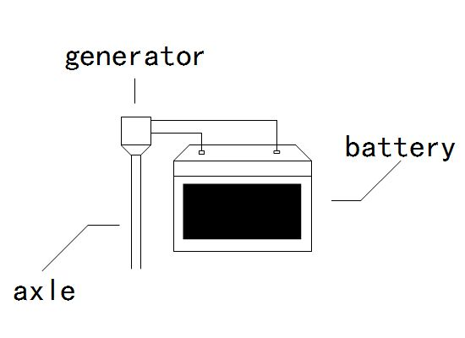
Blueprint

Slide 10
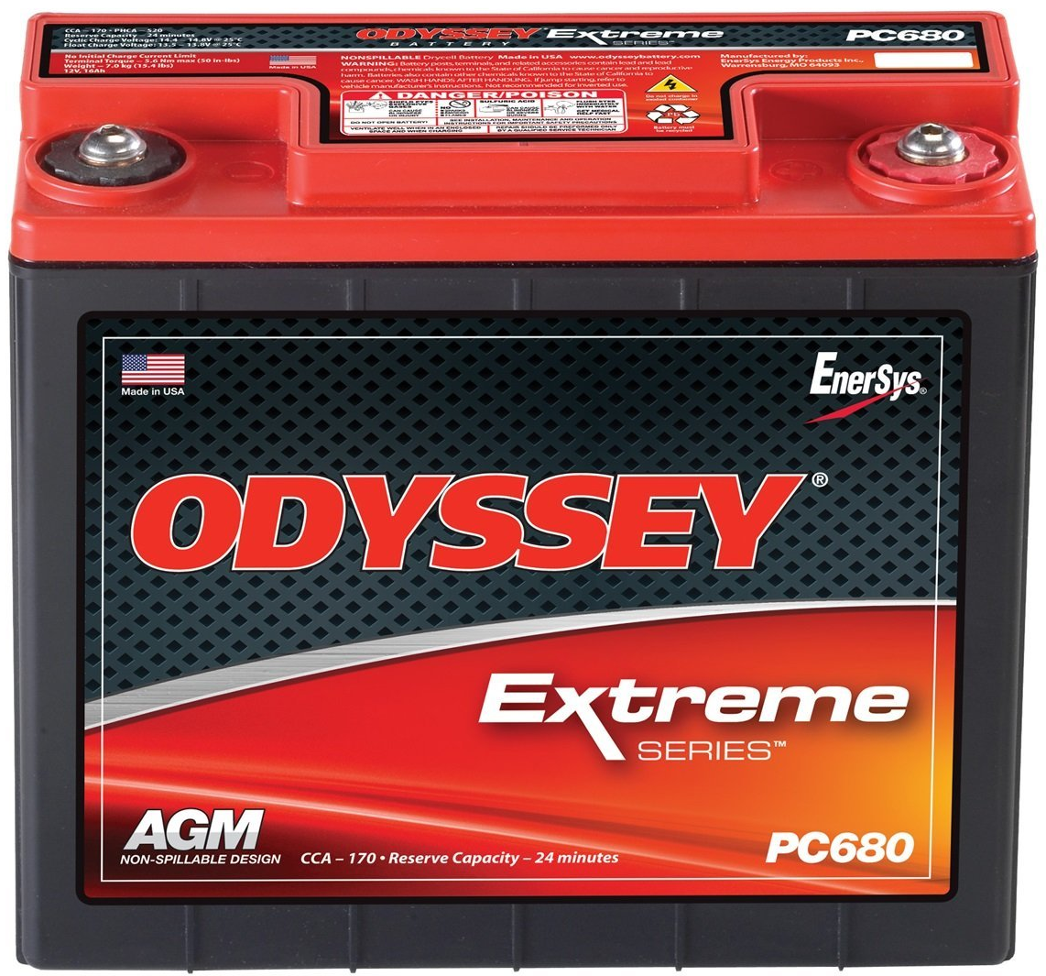
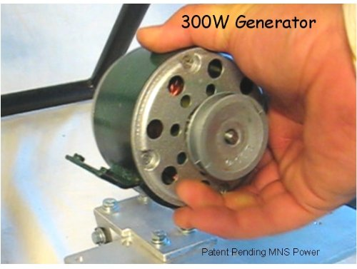
Generator
$200
Battery
$120

Slide 11
Time Table

Slide 12
Conclusion
Technological Difficulties
Advantages of our design
Outlook in future

Slide 13
Thank You
Any question?

